Slide 1
Parent Information Session – HSE – Austin 2015-2016
Welcome back!

Slide 2
Mrs. Kozlova – GATE coordinator & coach, Project coordinator, Russian Language Instructor (High school)
NOTE:
To change images on this slide, select a picture and delete it. Then click the Insert Picture icon
in the placeholder to insert your own image.
Bachelor Degree in Education (Russian Language & Literature; English Language)
3 years experience in Moscow Public School
4 years experience in HSE – Austin
Participated in WCECCE (World Conference on Early Childhood Care and Education organized by UNESCO (United Nations Educational, Scientific and Cultural Organization) – Moscow, 2010
Participated and won the Contest “The best teacher of the year 2010” in Moscow, Russian Federation
Received Texas State Certifications in English as Second Language, English Language and Arts, and Gifted & Talented Education.

Slide 3
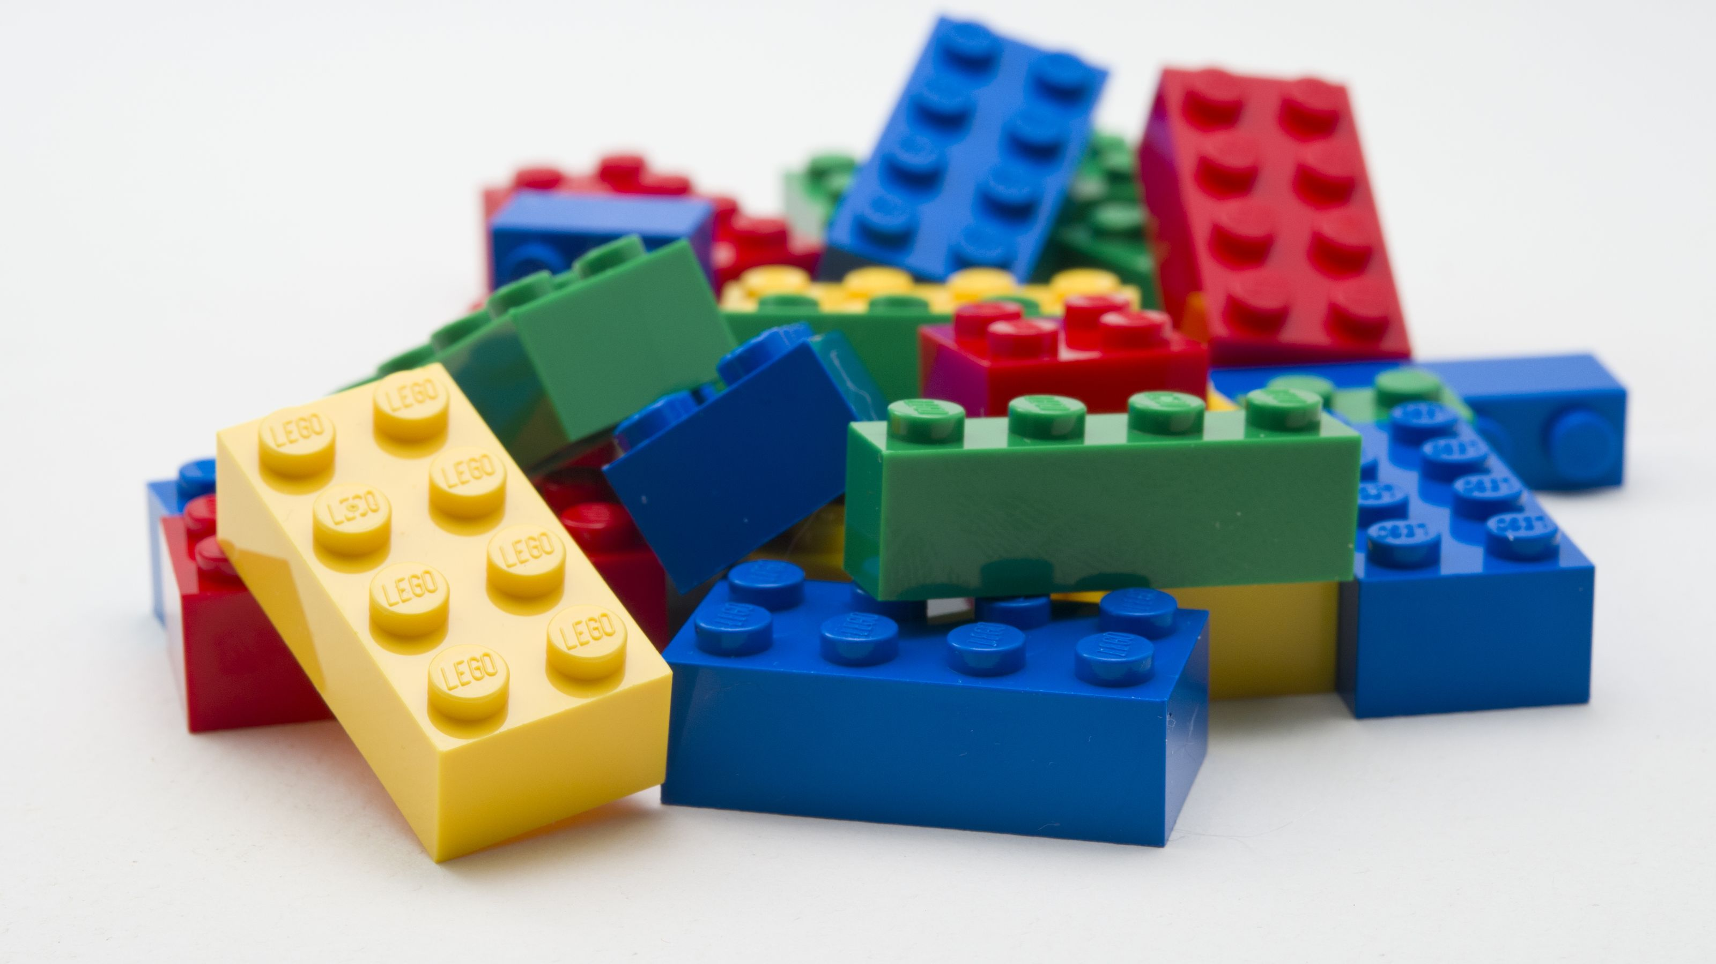

Slide 4
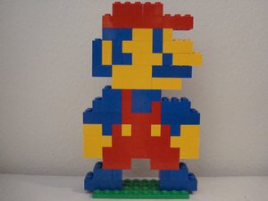
Do you like this Mario? Why?

Slide 5
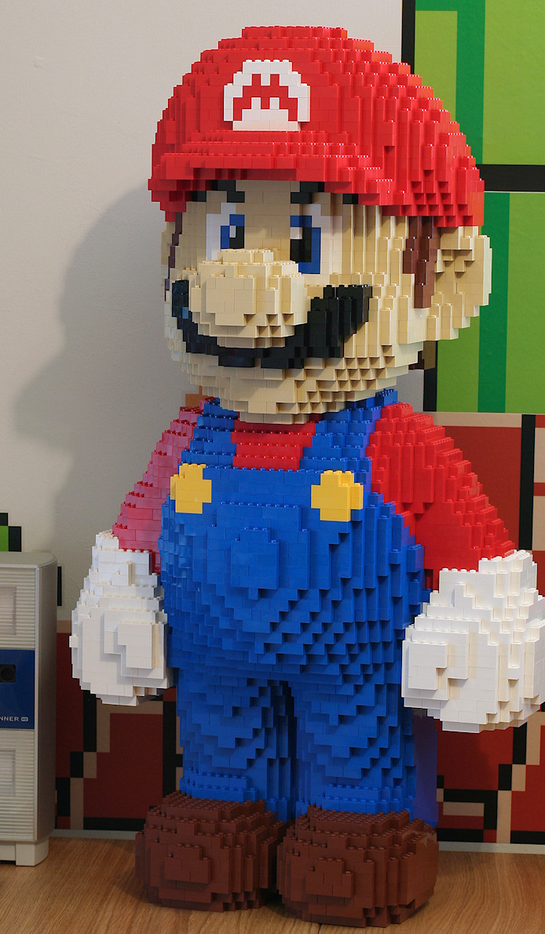
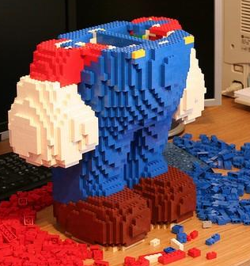

Slide 6
GATE curriculum
6th-8th grade – pull outs once a week during Math/English Lab
High school - differentiation materials during the regular class (9th grade)/ Scientific Research & Design class (10th, 11th, &12th grades)

Slide 7
Middle school schedule:
6th grade – 1st block on A Day (during ELA Lab) 8.00 am – 9.30 am
7th grade – 4th block on B Day (during ELA Lab)1.30 pm – 3.00 pm
8th grade – 1st block on B Day (during ELA Lab) 8.00 am – 9.30 am

Slide 8
6th grade – Culture Shock 7th grade – Game of Life 8th grade – Time travel
Resource: Texas Performance Standards Project
http://www.texaspsp.org/middleschool/middle-school-tasks.php

Slide 9
6th grade – Culture Shock
Culture Shock is a sixth grade interdisciplinary social science course. Culture Shock explores tourism as a historical, social, and cultural practice. This course is a modified Texas Performance Standards Project and is aligned with sixth grade Texas Essential Knowledge and Skills (TEKS) Culture Shock begins by defining tourism as a historical practice. Students will examine connections between tourism, discovery, cultural exchange, and social custom. The class will gain a nuanced understanding of travel by studying in depth dominant types of tourism, such as recreational, historical, sustainable, cultural, educational, among many others. During this learning phase of our work, students will take on the roles of Austin, Texas cultural ambassadors, charged with receiving different groups of exchange students. What will they see? Why? In addition, students will chose a country of interest and write a brief research paper from a touristic angle. To enhance our study, a range of guest speakers representing local travel agencies will join us to discuss the business of tourism. Students will choose an international destination and design a travel agency based around their country of interest. Students will craft a mission statement for their agency, provide historical context, geographic and cultural information, design three major genre packages (historical, cultural, and educational, for example), and craft a fictional travel blog available on a website of the student's making. Students are expected to account for rates of currency exchange, seasonality, cultural sensitivity, and mode of travel.

Slide 10
7th grade – Game of Life
The Game of Life is an interdisciplinary social science class, focusing on college and career awareness,research, and development of a personal life plan. Students in The Game of Life forecast their college attendance, including graduate and professional training, and discover various subsequent career and life paths. The Game of Life is a modified Texas Performance Standards Project and is aligned with seventh grade Texas Essential Knowledge and Skills (TEKS). During the learning phase of the course, roughly the first five months of school, students will research specific job titles and the subsequent academic training required of their chosen appointments. Students will explore colleges offering the majors they will need to gain entry level into the position, including professional and graduate school, and will arrive at a plan for achieving college admission. Students will gain a working knowledge of the resources available for researching colleges, by professional school, as well as earning assistantships, fellowships, and scholarships After developing a path for professional training, students analyze various salaries in their proposed fields (adjusted for inflation), and apply their earning potential to various life scenarios, including geographic region (adjusted for inflation), renting vs. owning, transportation plans, and associated incidentals. Speakers from local colleges and vocations will round out the students' learning.

Slide 11
Students use their learning phase research during the independent, or project, phase to develop a website detailing their plans, estimations, and rationales, as well as a digital portfolio which students may use throughout middle and high school to contain working resumes, biographies, academic achievements, and supporting information. Students will also identify and develop communication with a professional community mentor, such as a local professor, specialist, scientist, doctor, etc, who will assist students in shaping their life plans. Finally, students will develop a public awareness campaign about career fields and colleges for their local school community, which may include posters, class presentations, podcasts, and/or other creative avenues of creative expression. Students will share their projects with the school community during a GT showcase at the end of the academic year!

Slide 12
8th grade – Time Travel
Time Travel is an interdisciplinary Gifted and Talented Course, modified from Texas Performance Standards Project. Students in Time travel apply historical consciousness and methodologies to a range of primary sources to interpret past and present through authentic projects.
Time travel begins with an interrogation of what constitutes history and explores the interpretation of primary and secondary documents situated in social and cultural context. Students read primary source texts (documents) and situate them within historical context using secondary sources. After thoroughly researching a time period of interest, students connect cultural and popular themes of the era to material, popular, folk, archival, among other artifactual sources. Students draft original, professional-quality research papers, organize and present at a mini-academic conference, investigate differing scholarly interpretations and arguments and develop a culminating interdisciplinary project showcasing connections between, at least, three, primary source documents (one of which must be a pivotal work of fiction or non-fiction) and major themes of an era.

Slide 13
Examples of Past Projects Include:
Historical fiction novel about women’s suffrage in Texas
Documentary on Flight and culture in the 1950s
Puppet Theater depicting History and culture of psychotherapy in the United States
Research paper on Militaristic Origins of Video Games
Oral History of African American Civil Rights Movement in Austin, TX

Slide 14
High school:
Scientific Research & Design Class – 10th – 12th grade
A Day – 4th block – 1.30 pm – 3.00 pm
B Day – 2nd Block – 9.34 am – 11.04 am
9th grade - differentiation materials during the regular class

Slide 15
ADVANCED LEVEL RESEARCH PROJECT The following two contest paths will be our targets.
Harmony Austin (Cluster wide science fair) Austin Energy regional science festival
H-SEF (Harmony Science & Engineering Fair) ExxonMobil Texas Science and Engineering fair
JSSE in Hong Kong INTEL International Science and jjj Engineering fair
INESPO in Netherlands
MOSTRATEC in Brazil The White House Science Fair
I-SWEEEP in the U.S.

Slide 16
Winners from Harmony School of Political Science
MOSTRATEC in Brazil JSSE in Hong Kong
Objective: develop a web-based system to gather information from the drivers and passengers for car-pool.
While assigning the passengers to their drivers, cluster them in a way to minimize total distance to travel.
Find the shortest way for drivers to pick up and deliver the passengers.
Objective: to develop an efficient and cost effective method for detecting diseased corn plants in large farms using Image Processing and Artificial Intelligence algorithms and autonomous drones.

Slide 17
HELP NEEDED! We need mentors with engineering background. If you know somebody who is willing to help our students with their Science Projects, please refer them to Mrs. Kozlova
NOTE:
To change images on this slide, select a picture and delete it. Then click the Insert Picture icon
in the placeholder to insert your own image.

Slide 18
Any ideas for the Field trips? Please, email me: ykozlova@harmonytx.org
NOTE:
To change images on this slide, select a picture and delete it. Then click the Insert Picture icon
in the placeholder to insert your own image.

Slide 19
I Want to Volunteer – PTO form
NOTE:
To change images on this slide, select a picture and delete it. Then click the Insert Picture icon
in the placeholder to insert your own image.

Slide 20
Contact Information:
Room # 111 (middle school building)
Phone: 512-525-7573
(text is better)
Email: ykozlova@harmonytx.org
Website: http://hseaustingt.weebly.com/

Slide 22
THANK YOU for being a part of our team!!! Your support matters!

